Slide 1
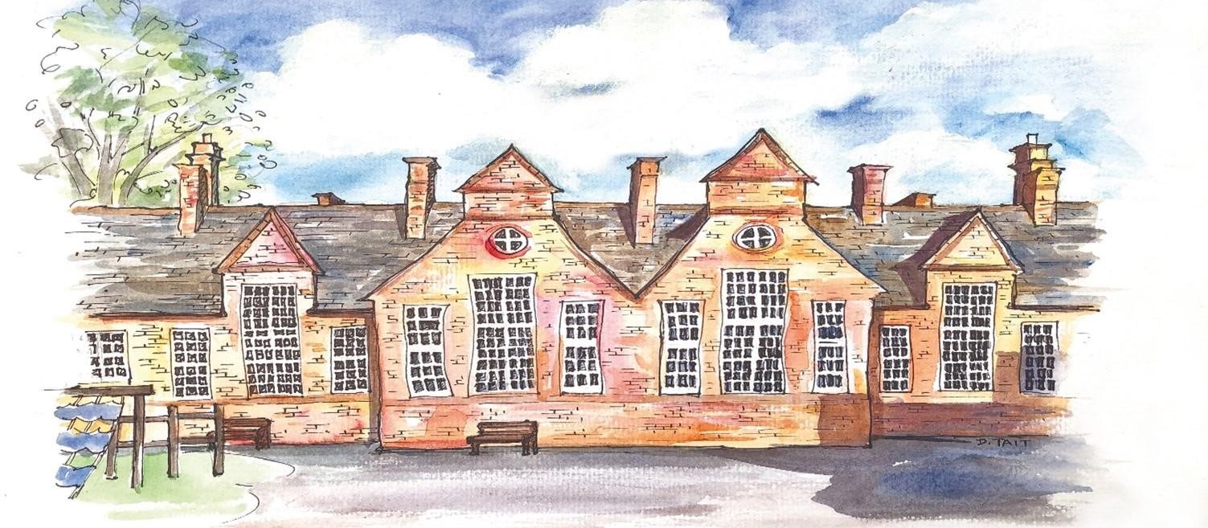
Welcome to Year 3 and 4

Slide 2
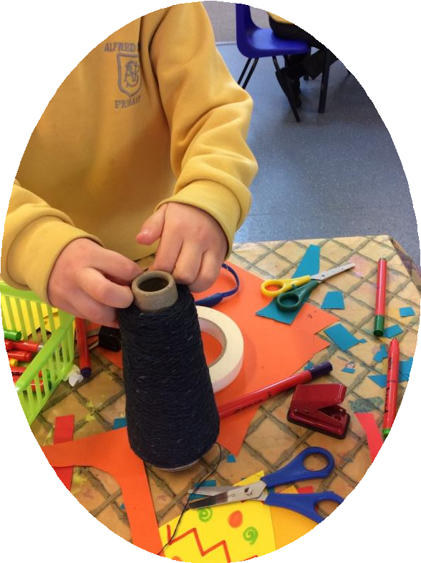
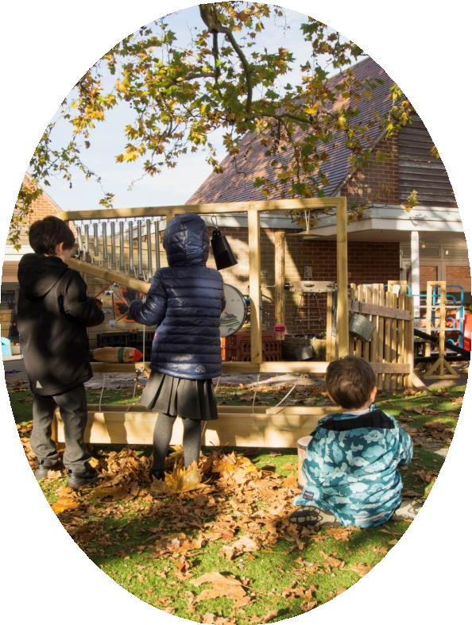
Welcome to Alfred Sutton Primary School
We would like to welcome you to Years Three and Four at Alfred Sutton Primary School. We are ready to help you and your child embark upon the next part of their learning journey.
At Alfred Sutton we aim to ensure that everyday is full of purposeful learning driven by an exciting and creative curriculum.

Slide 3
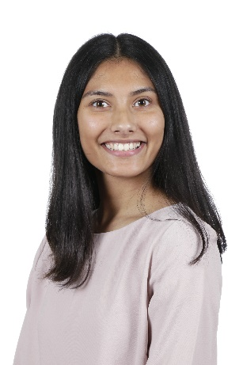
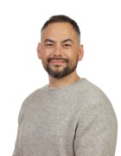
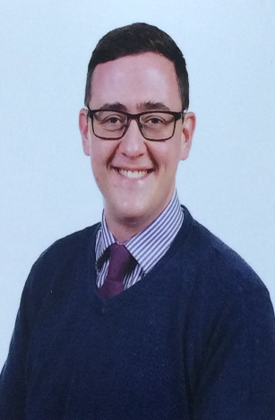
Teachers in Year 3
 | Miss Ahmed Year 3 Rabbit | Mr Lim Year 3 & 4 Phase Lead Hedgehog | Mr Higgs Year 3 Squirrel

Slide 4
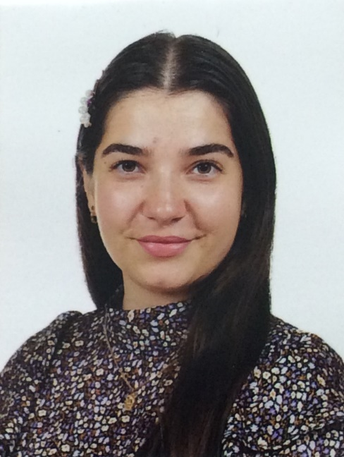
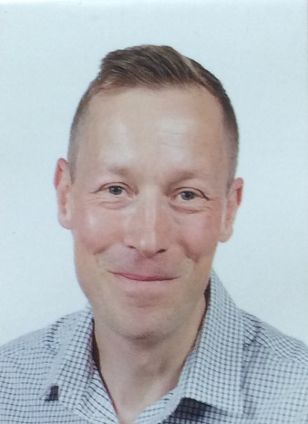
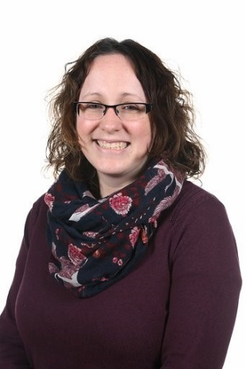
Teachers in Year 4
 | Miss Selwood Year 4 Badger | Mr Watson Assistant Head Teacher Otter | Mrs Gurr Year 4 Fox

Slide 5
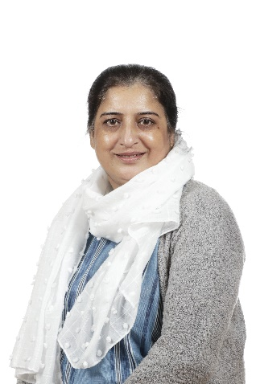
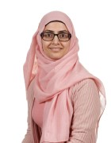
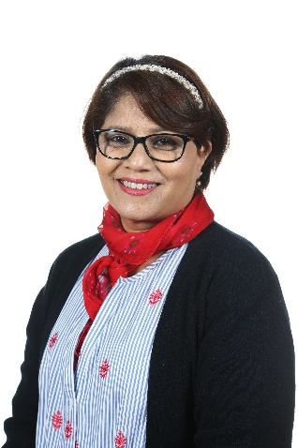
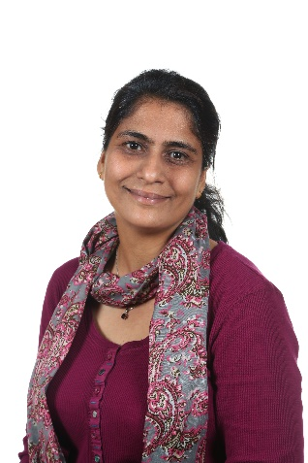
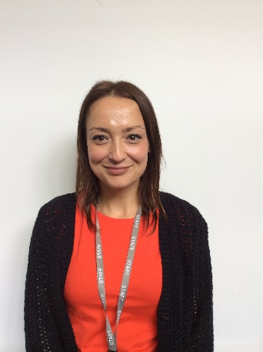
Support Staff in Year 3/4
Mrs Amjad
Mrs Ilbery
Mrs Afzaal
Mrs Imran
Mrs Amjad
Miss Kervin
Mrs Nair

Slide 6
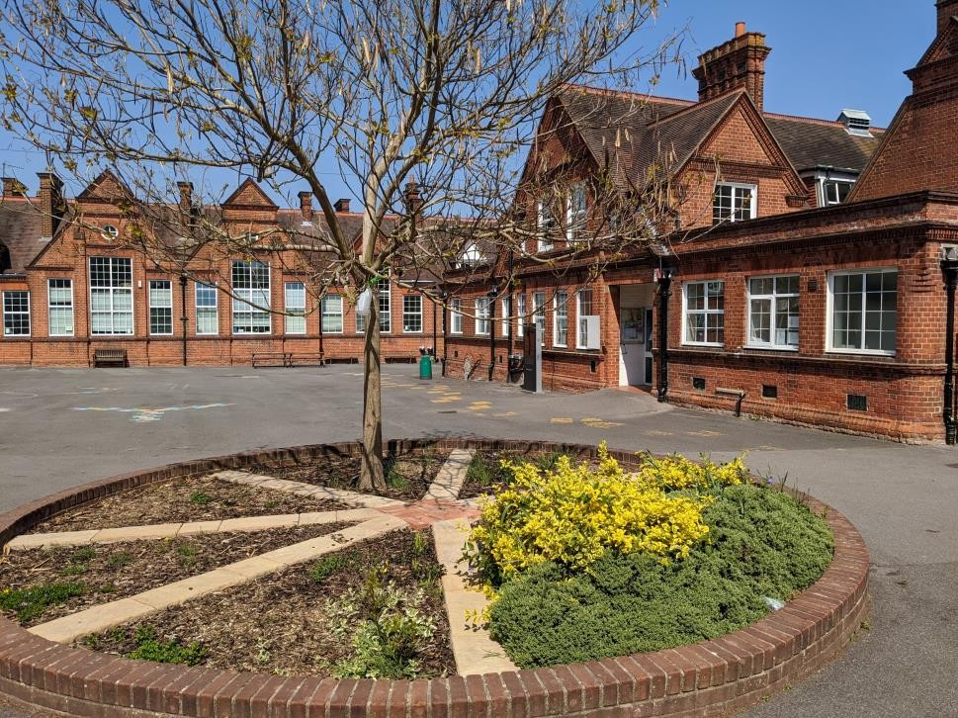
Transition from Y2 to Y3 and Y3 to Y4
Transition is very important. We want your child to feel happy and confident in their new environment and with new staff.
Children will meet their new teacher before the summer holidays. This is an opportunity for them to ask questions.

Slide 7
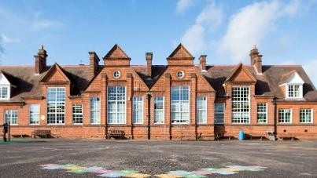
Transition at Alfred Sutton Primary School
Transition events
Communication with previous teachers
Meet the teacher events for children
Photobooks via Weduc

Slide 8
Learning in Year 3 & 4
 | Writing Skills | Maths |  | Reading Skills
 | Write coherent narratives Use present/past tense Use capital letter, full stops correctly, commas, speech marks Spacing and letter size is correct Cursive Handwriting | Arithmetic Reasoning Times tables/Number bonds and division |  | Summarise text Answer literal questions Sound out unfamiliar words Start making inferences Reading frequently Retrieval Building vocabulary
 | Wider Curriculum
 | Geography History Science Art/DT Drama |  | Nutritional and outdoor learning Music RE PSHE PE

Slide 9
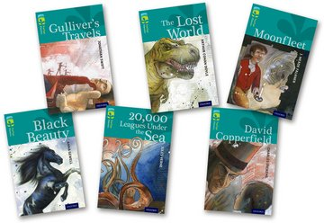
Reading Books
Your child will bring home a reading book and a reading diary.
Books will be allocated based on your child’s reading level.
Reading books and reading diaries must be brought into school every day.
Books must be kept in a suitable bag.
We are unable to allocate a new reading book if the previous book has not been returned to school.
Children are expected to read at home daily and read aloud to an adult at least three times a week.
Writing in reading diaries:
Adults please write a comment in your child’s reading diary when they read their book to you.
KS2 – children are expected to fill in their reading record independently if they read on their own.

Slide 10
Home and school working together to support
learning
Homework
Once a week, we will send home pieces of homework that reinforce our learning in school.
Every night
Read for at least 10 minutes.
Number skills (Times tables, division and number bonds)
Having conversations about their learning.

Slide 11
The school day
A typical school day:
8.30am – school gates open.
8:40am - Year 3 and 4 doors open.
8:50am - Class doors close at and the register is taken. Children arriving after the doors have closed will need to be signed in at the office and will be marked as late.
9:00am – the morning includes lessons in reading, writing and maths. During the morning, there is short Activefit break and a mid-morning playtime.
12:20-1:20pm Lunch Break.
1.20pm – The afternoon includes wider curriculum lessons and reading for pleasure.
3.10pm – school ends.
Collection - wait in the playground outside the classroom and your child will be sent to you. Please do not come up to the classroom door.

Slide 12
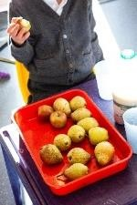
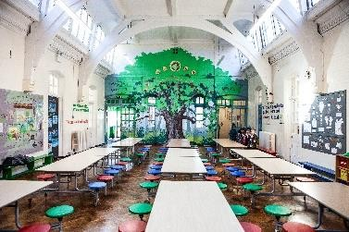
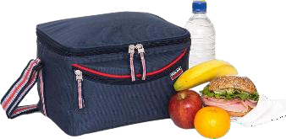
The school day
Water – please bring in a named water bottle
Snack – a piece of fruit or vegetable
Lunchtime
School dinner
ParentPay - ordered before 8am
Packed lunch
Healthy and balanced
No nuts

Slide 13
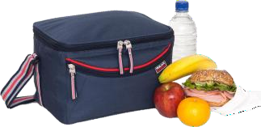
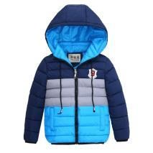
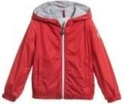
What to bring to school everyday
book bag
water bottle
lunch box/bag (if applicable)
coat (suitable for all types of weather) | PE kit
A hat, scarf and gloves are needed for colder days
A sun hat is needed for warmer days (please apply sun block at home)
All clothes and other items that your child brings to school need to be named

Slide 14
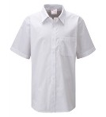
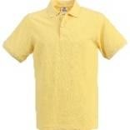
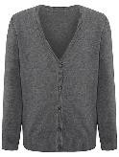
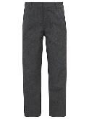
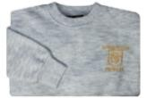
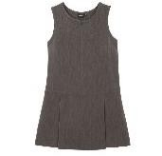
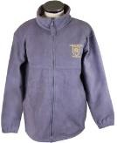
School Uniform
shirt or blouse | polo shirt | jumper/ cardigan | sweatshirt | trousers/ shorts
skirt/ pinafore | summer dress | leggings | black shoes | school fleece
Our school colour is yellow and is teamed with white and grey
You can purchase items of clothing with the school logo on from Stevensons www.stevensons.co.uk
Please ensure your child is dressed suitably for the weather – we are outside at much as possible
All clothes and other items that your child brings to school need to be named

Slide 15
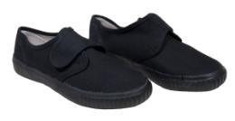
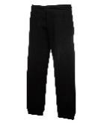
PE kit
 | PE shorts | PE leggings | PE t-shirt
 | plimsolls/ trainers | PE jogging trousers | PE sweatshirt
Children should wear PE kit to school on their PE day (PE days may move) Suitable kit for PE lessons outside Children with long hair should have it tied back on PE day Change into PE kit in school if they have an extracurricular sport club Year 3 PE every Wednesday Year 4 PE every Tuesday

Slide 16
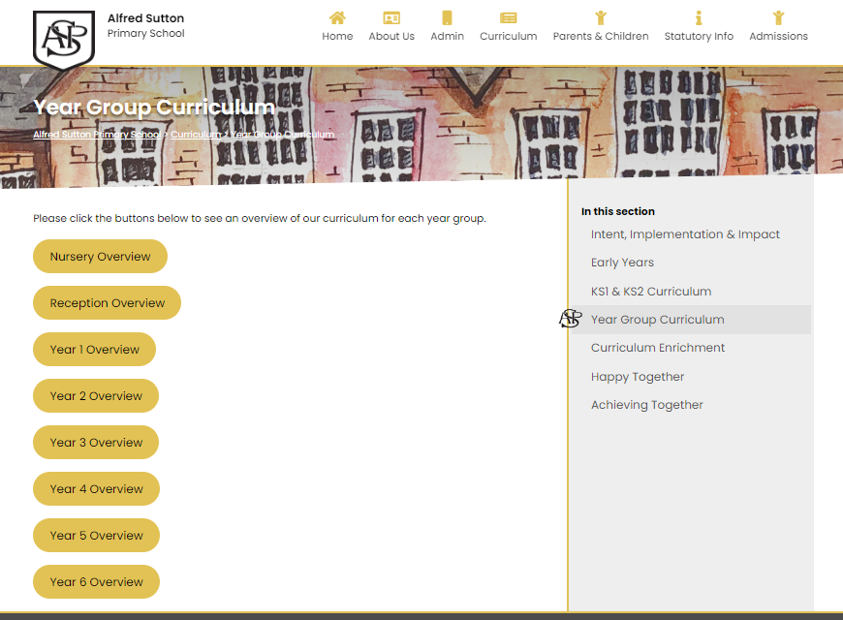
Learning in Year 3 & 4 Year group curriculums are available to view on the Alfred Sutton website - https://alfredsuttonprimary.co.uk/ Curriculum – Year Group Curriculum This gives a summary of your child’s learning for the year.

Slide 17
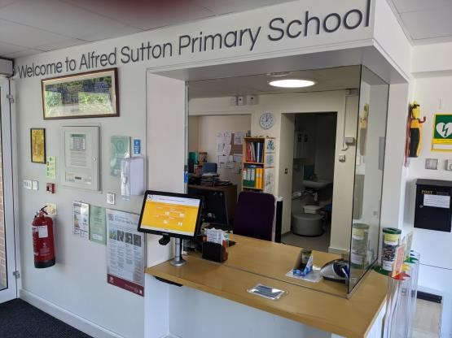
Life at school
The school office
Communication – weduc
www.weduc.co.uk
Events
Letters
Changes in usual collection
Illness reporting - attendance
After School Childcare and Extra-Curricular Clubs
www.getactivesports.com

Slide 18
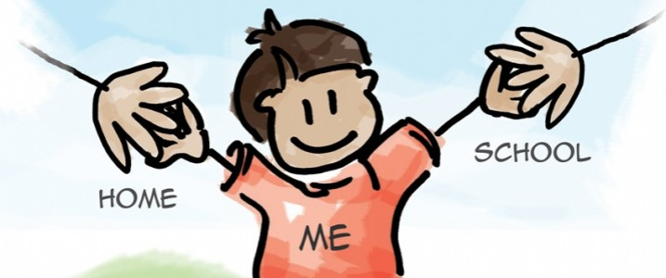
Home and school working together to support learning
How to support your child with their learning:
Ensure you child is in school and on time (8:40)
Homework
Once a week, we will send home pieces of homework that reinforce our learning in school.
Every night
Read for at least 10 minutes.
Review number skills (times tables, division, number bonds…)
Have conversations about their learning.

Slide 19
Thank you!
We look forward to meeting you in the coming weeks..

