Slide 1

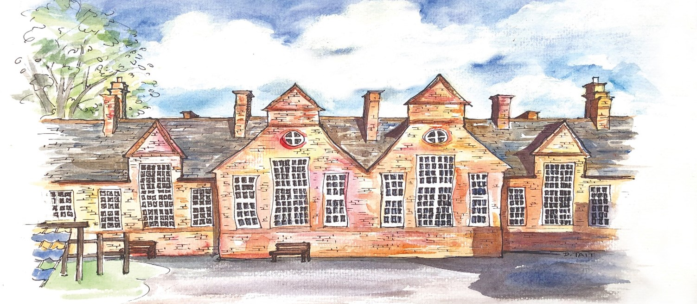
Alfred Sutton Nursery

Slide 2

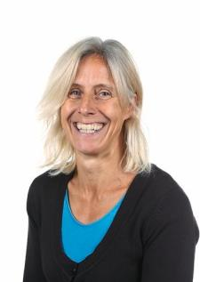

Meet the Nursery Team
Ms
Mussett
Nursery Lead (based in Fern)
In charge of Teaching and Learning
Mrs Sylvie Sewell
Our Nursery Admissions Assistant
In charge of Administration

Slide 3
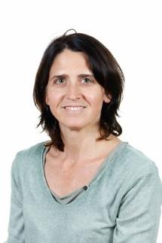
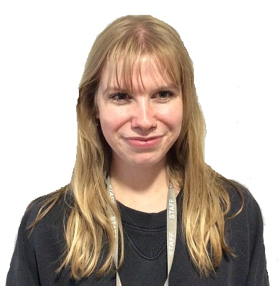
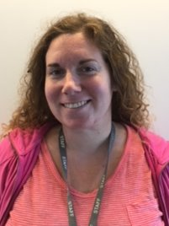
These are the Key Persons
(EYPs and teacher) teaching in Fern Class
Mrs Sanchez (Tues, Wed, Thurs)
Mrs Lopez
(Mon, Fri)
Ms Mussett
Miss Littlewood

Slide 4
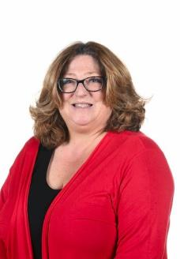
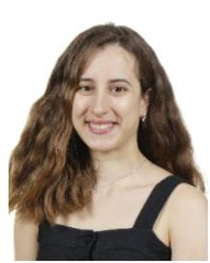
These are the Key Persons (EYPs) teaching in Toadstool Class
Ms Katsika
(After October Half Term)
Mrs
Banning
Mrs Salman

Slide 5
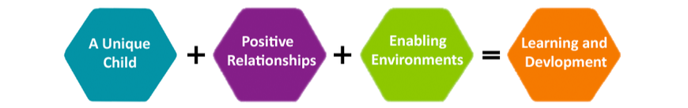
Early Years Foundation Stage
The EYFS is based on four principles:
  The Unique Child
  Positive Relationships
  Enabling Environments
  Learning and Development
Every child is unique and individual and will make progress at different rates. Positive relationships and enabling environments will stimulate children’s curiosity and help them thrive, learn and develop.
These principles underpin all aspects of teaching and learning in the Early Years Foundation Stage.

Slide 6
Learning in the Foundation Stage
In Nursery we focus more on the Prime Areas
Prime Areas
Personal, social and emotional development Communication and language Physical development
Specific Areas
Literacy Mathematics Understanding the World Expressive arts and design
Characteristics of Effective Learning
Playing and exploring Active learning Creating and thinking critically

Slide 7
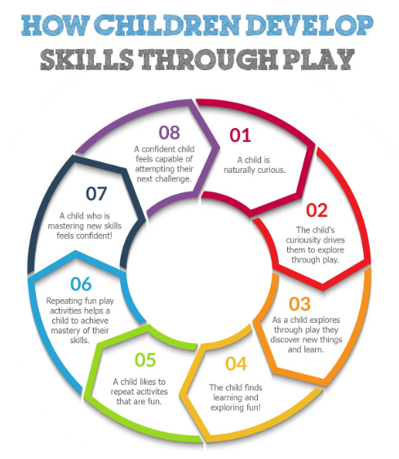
Learning Through Play
Play is the best way for children to develop and master
the skills within the EYFS framework.
  Develops communication skills
  Supports cooperation
  Allows application of skills
  Provides challenge
  Builds relationships
  Lots of fun!

Slide 8

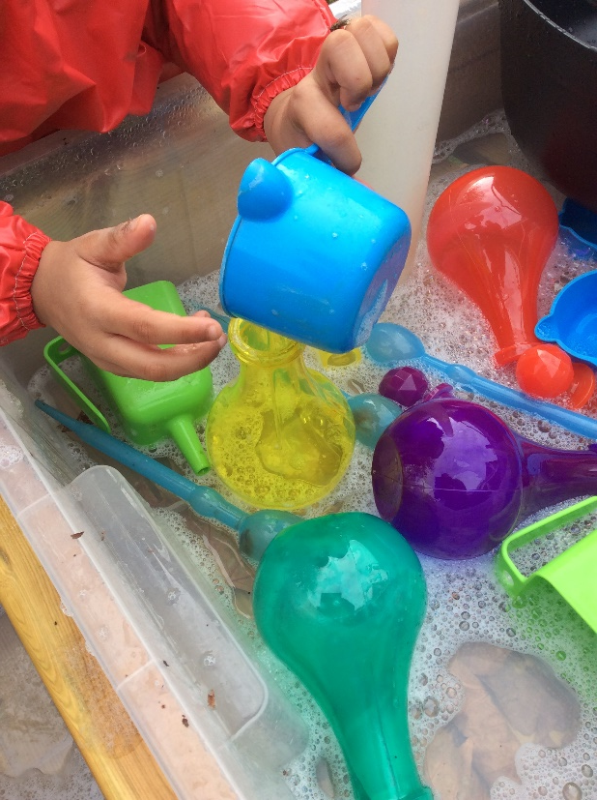
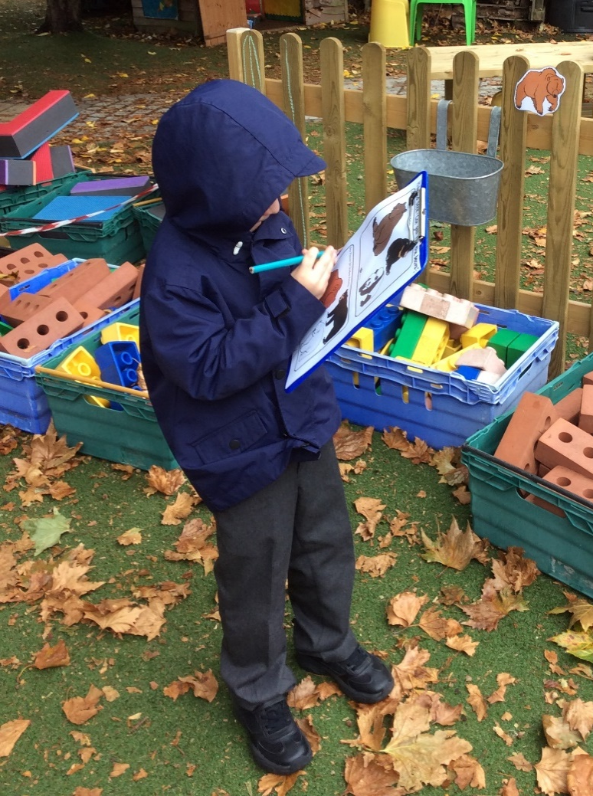
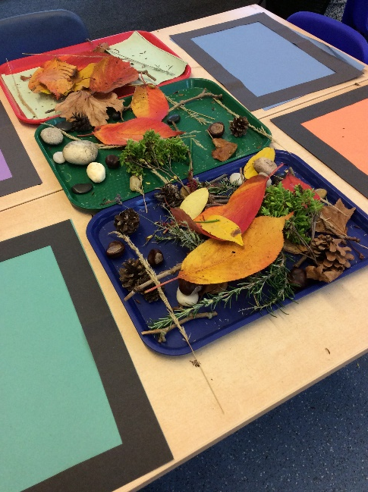
Learning in Nursery
Alongside play and following the children’s interests, we use an integrated text-based approach to planning.
  Weekly high quality text and Nursery Rhymes
  Engaging topics
  Introducing and developing vocabulary
  Exciting, open ended activities
  Balance of adult-led and child-initiated learning
Use of the inside and outside environments

Slide 9
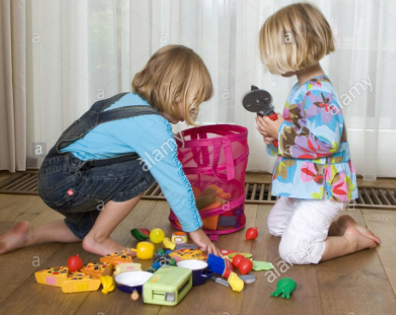
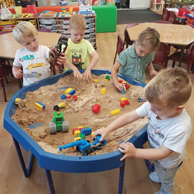


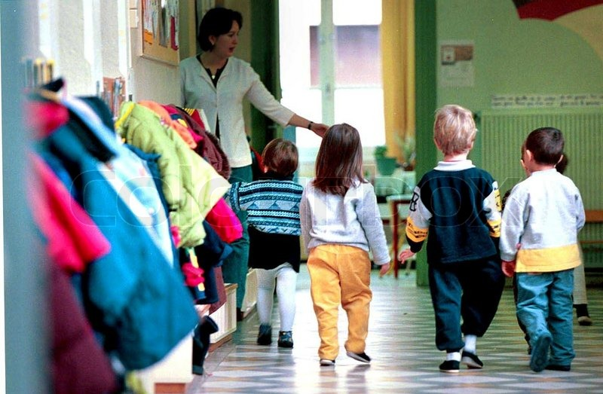
In Nursery we focus on Personal, Social and Emotional Development
tidy up our toys
share and take turns
play together with our friends, using kinds hands, kind words and kind feet.
walk inside
look after our friends

Slide 10
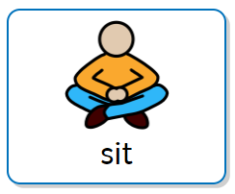



In Nursery we focus on Communication and Language skills through carpet time, key groups and free flow play.
On the carpet we practise our listening and attention skills by:

Slide 11
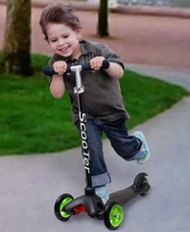
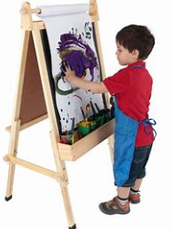

We develop our Physical Development skills through Gross and Fine motor skills
running
jumping
climbing
scooting
ribbons
threading
mark making
stacking
playdough
scissor skills

Slide 12
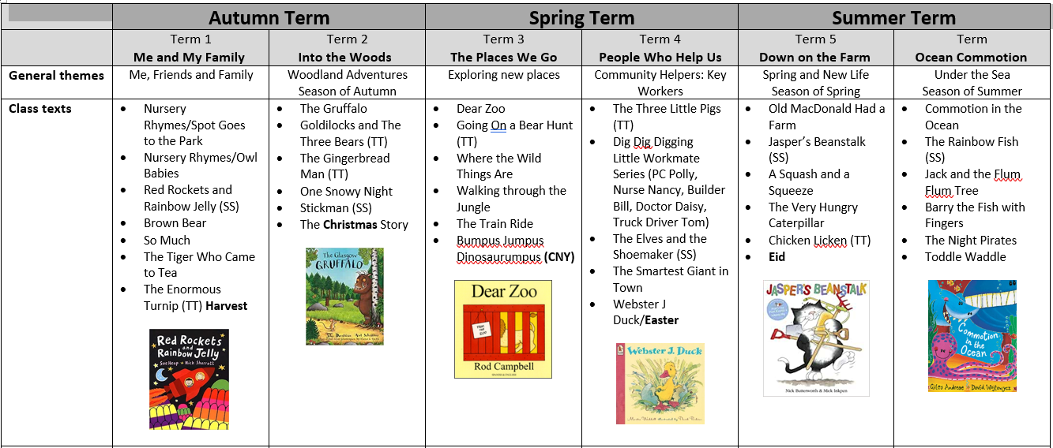
Our Weekly Learning: text and topic based
More detailed plans covering all areas of learning can be accessed via the School Website
@ https://alfredsuttonprimary.co.uk

Slide 13
The school day
We have our own large, well resourced outside area and children have access to both inside classrooms during free flow time. Take a look at what a typical day looks like:
In addition ALL Day children have a supervised lunchtime and play break from 11.30-12.20
Morning sessions (8.40-11.40)
8.40- 50am Soft start to the day : Nursery doors open – say goodbye to parents and free choosing to settle
9.05 Carpet time: Welcome and Registration
9.10-9.30 Carpet time based on the week’s learning
9.30-11.00 Open up for free flow choosing, inside and out, free flow snack
11-11.10am Tidy up and Book Look
11.10-11.25 Key Group time (activity based on week’s learning and/or identified next steps
11.30-11.35 Rhyme time and active 5
11.40 Home time
Afternoon sessions (12.20-3.20)
12.20- 30pm Soft start to the day: Nursery doors open – say goodbye to parents and free choosing to settle
12.30-12.35 Carpet time: Welcome and Registration
12.40-1pm Carpet time based on the week’s learning
1pm-2.30 Open up for free flow choosing, inside and out, free flow snack
2.30-2.40 Tidy up and Book Look
2.40-3.00 Key Group time (activity based on week’s learning and/or identified next steps)
3.00-3.10 Rhyme time and active 5
3.15/20 Home time

Slide 14

Introducing Phonics
(hearing, saying, recognising sounds and letters)
The emphasis in Nursery is for the children to begin Tuning into Sounds. (hearing and saying sounds in words) We do this by:
Sound of the Week
Playing initial sounds games, I spy
Singing Nursery Rhymes
Hearing rhymes in words
Clapping syllables
In Reception the children begin their reading journey using the systematic phonics programme Read Write Inc. Phonics.

Slide 15
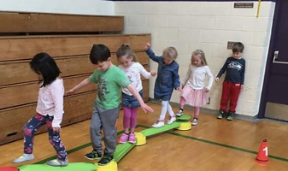
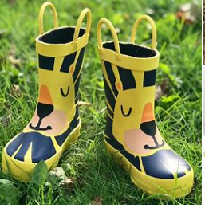

Curriculum Enrichment
Nursery children have the opportunity to visit the school library, have PE (Mr Neate) and go on an Outdoor Learning Welly Walk every two weeks.

Slide 16
How to help your child develop independence and self regulation skills
Self care independence -putting on their shoes, zipping their coats and beginning to eat with a knife and fork/spoon independently
Drinking from a cup (not a bottle)
Move towards independent toileting and washing their hands by themselves
Take time to talk to and listen to your child, asking them to follow simple instructions
Practice waiting for their turn by taking turns with family and friends (My turn, Your turn)
Count everyday items (when shopping) and recognise numbers in the environment
Look at and read books, talk about the pictures and what happened
Tune into sounds: Go on a Listening Walk, Play I spy
Sing songs and nursery rhymes
Help teach your child to recognise and begin to write their name using capital and lower case letters (We send home their name card at Easter)
Set a designated screen time and stick to it! Make sure the content they are watching is suitable (not free range Youtube) Set Parental Controls on devices they use

Slide 17

Tapestry: Parents as Partners
A secure online learning journal where you can see:
  Photos and videos of your child’s play and learning at school.
  Comments between home and school on observations
  Weekly learning updates
  Access Home Learning activities
  ‘WOW’ moments (festivals, visits and special celebrations)
We welcome your observations from home
www.tapestryjournal.com

Slide 18
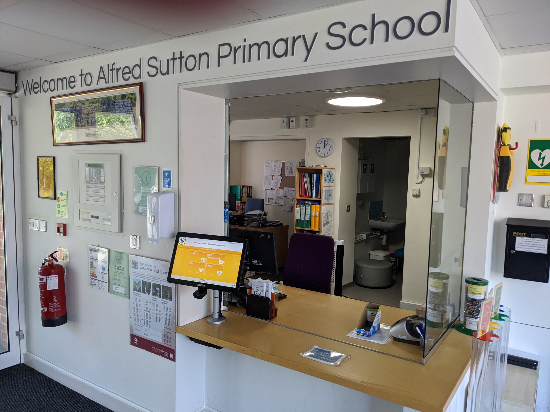

Life at school
The school office
Communication is through Weduc
  www.weduc.co.uk
  Events
  Letters
  Changes in usual collection
  Illness reporting - attendance

